Slide 1
Lecture 3: Money View Fundamentals
Perry Mehrling
Warsaw School of Economics
October 13, 2017

Slide 2
The Money View
Banking as a Payments System
Copeland (1952): A Moneyflow Economy
Minsky (1957): The Survival Constraint
Banking as a Market Making System
Hawtrey (1919): Hierarchy of Money and Credit
Hicks (1989): Centrality of the Dealer Function
Bagehot (1873): Dealer of Last Resort

Slide 3
Banking as a Payments System

Slide 4
I. A Moneyflow Economy (Copeland)
Money Flows vs. NIPA, Equation of Exchange
Monetary liquidity, Funding liquidity, Market Liquidity
Uses | Sources
Expenditures (G&S) | Receipts (G&S)
Asset Accumulation Debt Repayment Hoarding | Asset Decumulation Borrowing Dishoarding

Slide 5
Payment Mechanics
Me Vareli Mastercard
I buy a meal at Vareli restaurant, paying with my credit card
Expenditure |  |  | Receipt
 |  | Accumulation |  | Accumulation
 | Borrowing from MC |  |  |  | Borrowing from Vareli

Slide 6
II. The Survival Constraint (Minsky)
Time pattern of cash flows, cash commitments
Reserves (discipline), final payment
Cash inflow >= Cash outflow, settlement
Asymmetric constraint, binding deficit agents
Credit (elasticity), delaying day of reckoning
Borrowing, secured and unsecured
Asymmetric constraint, binding deficit agents
Credit relaxes discipline today, tightens discipline tomorrow

Slide 7
Settlement Mechanics, I
Me Vareli Mastercard
Mastercard settles its debt with Vareli by transferring money
 |  |  | Decumulation
 |  |  |  | Repay Vareli
 |  | Hoarding |  |  | Dishoarding

Slide 8
Settlement Mechanics, II
Me Vareli Mastercard
I settle my debt with Mastercard by transferring money
 |  |  |  |  | Decumulation
Repay MC
 | Dishoarding |  |  | Hoarding

Slide 9
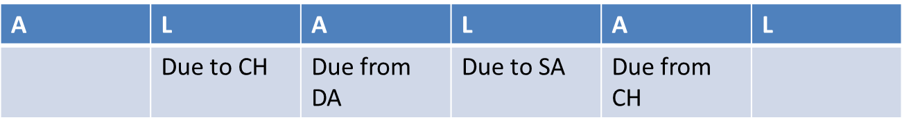
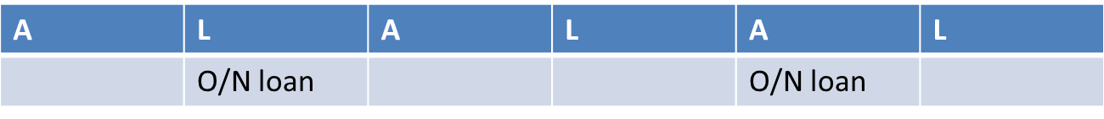
Settlement and Money Markets: Intraday versus Overnight
Deficit Agent Clearing House Surplus Agent
O/N loan = Fed Funds, Repo, Eurodollar
Central Bank Discount Window as last resort

Slide 10
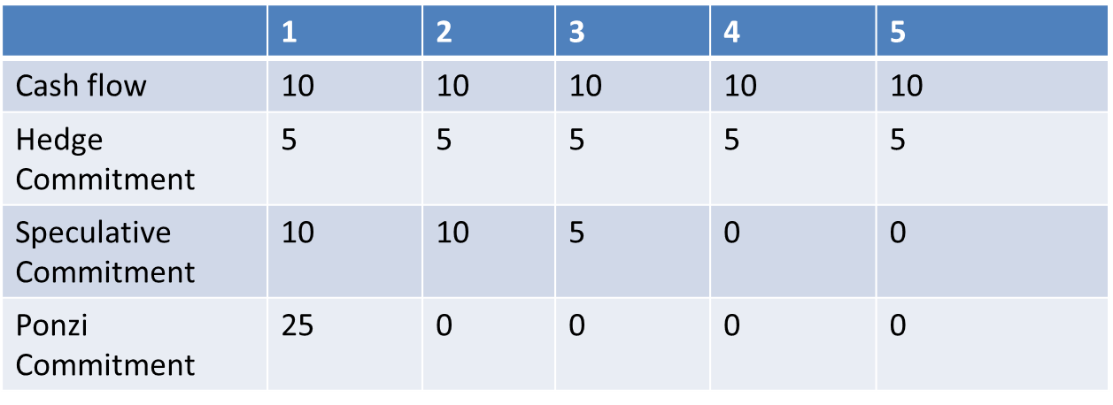
Liquidity, not Leverage
Total assets = 50, Total Liabilities = 25, in all three cases, so leverage is the same
Survival constraint however is increasingly binding, requiring refinance, willing counterparty

Slide 11
Survival Constraint and Economic coordination

Slide 12
Microeconomic Coordination
Deficits at clearing as a market signal
Misalignment of individual cash flows and cash commitments
Deficits at clearing as market discipline
Asymmetry of survival constraint
Enforcement by creditor lending decisions

Slide 13
Macroeconomic coordination
Money market interest rate as market signal
Misalignment of market-wide cash flows and cash commitments, pushing rates up or down
Money market interest rate as market discipline
Misalignment of market-wide cash flows and cash commitments, shows up in pattern of rates

Slide 14
Pattern of Interest Rates
Time: Term Structure of Interest Rates
Versus Expectations Hypothesis
Space: FX Structure of Interest Rates
Versus Uncovered Interest Parity
Risk: Risk Structure of Interest Rates
Versus Unbiased Default Premium
Liquidity

Slide 15
Stabilization Policy
MONETARY policy works by relaxing and tightening the survival constraint
Direct consequences for money rate of interest
FISCAL policy works on cash flows and cash commitments directly
Indirect consequences for money rate of interest

Slide 16
Banking as a Market Making System

Slide 17
III. Hierarchy of Money and Credit (Hawtrey)

Slide 18
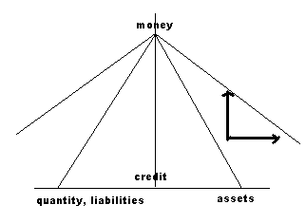
Dynamics
Elasticity and Discipline, Boom and Bust

Slide 19
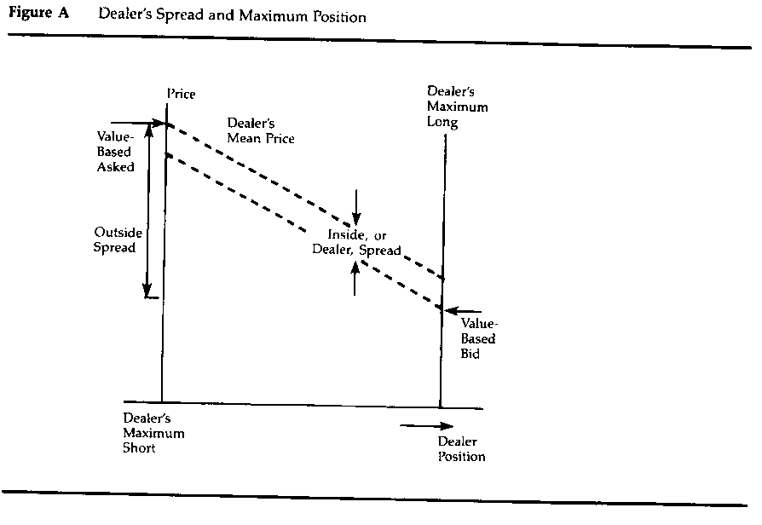
IV. Centrality of the Dealer Function (Hicks)
Treynor, 1987

Slide 20
Funding Liquidity and Market Liquidity

Slide 21
Liquidity and Efficiency
Price in general unequal to Value, on account of dealer expected profit
But dealer function does play a stabilizing role, absorbing in quantity (inventories) what would otherwise have to be absorbed in price

Slide 22
Liquidity and Arbitrage
Forward Interest Parity
[1+R(0,3)][1+F(3,6)] = 1+R(0,6)
Expectations Hypothesis
F(3,6) = ER(3,6)? NO, dealer expected profit!
Covered Interest Parity
[1+R*(0,T)]S(0) = [1+R(0,T)]F(T)
Uncovered Interest Parity
F(T) = ES(T)? NO, dealer expected profit!

Slide 23
What do dealers do?
“Normal” crisis
HH Dealer Bank
Prices create incentive for dealer and bank balance sheet expansion
Security prices fall, creating expected profit for dealer
Loan rates rise, creating expected profit for bank
Assets | Liabilities | Assets | Liabilities | Assets | Liabilities
-security +money |  | +security | +loan | +loan | +money

Slide 24
V. Dealer of Last Resort (Bagehot)
“Serious” crisis: LOLR
HH Dealer Bank Cbank
Global Financial Crisis: DOLR
HH Dealer Bank Cbank
Assets | Liabilities | A | L | A | L | A | L
-security +deposit |  | +security | +loan | +loan +reserves | +deposit +loan | +loan | +reserves
A | L | A | L | A | L | A | L
-security +deposit |  |  |  | +reserves | +deposit | +security | +reserves

Slide 25
Market making and economic Coordination

Slide 26
Why does Monetary Policy Work?
Banking as a Payments System
Settlement constraint and overnight funding
Banking as a Market-Making System
Dealer positions and price distortions
Money market funding
Capital market lending

Slide 27
Capital Finance, indirect
 | Capital Market | Federal Reserve | Banking
Money | Repo | Rate Target | Fed Funds
 | Commercial Paper | Treasury Bills | C&I lending
Credit | Corporate Bonds | Treasury Bonds | Mortgage lending

Slide 28
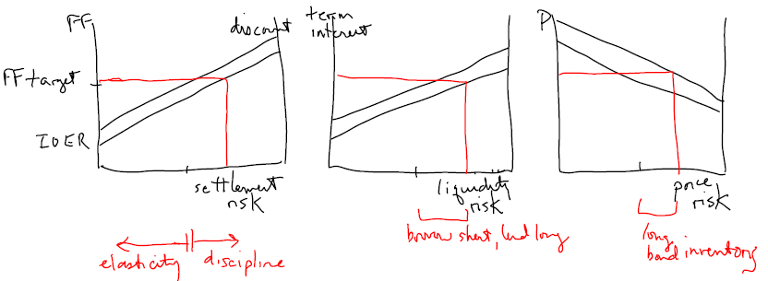
Monetary Policy Transmission

Slide 29
Pattern of Interest Rates
Time: Term Structure of Interest Rates
Liquidity Premium vs Expectations Hypothesis
Space: FX Structure of Interest Rates
Liquidity Premium vs Uncovered Interest Parity
Risk: Risk Structure of Interest Rates
Liquidity Premium vs Unbiased Default Premia

Slide 30
Central Question
What is the optimal price of liquidity?
Hard to answer from economics view, finance view
De facto, markets have begun to price liquidity
Negative basis swap
De facto, central banks are backstopping
Global liquidity swap network
“Money does not manage itself”

Slide 31
What is a financial crisis?
A liquidity event
Violation of “survival constraint” at the clearing, excess discipline
Failure/refusal of higher level, insufficient elasticity
Consequent unravelling web of mutual financial obligations, i.e. society
Incoherence until new foundations, for new credit expansion

Slide 32
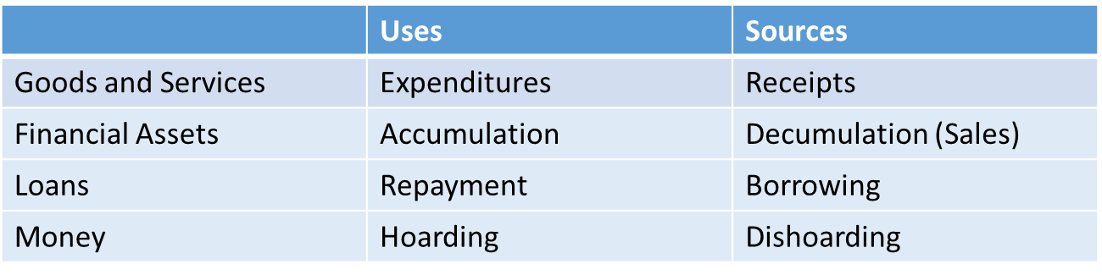
Institutional Evolution of Liquidity
Deficit agents on G&S settle with Surplus Agents using what?
1950s: Monetary Liquidity
1970s: Funding Liquidity
1990s: Market Liquidity
Financialization means relative growth of non-G&S account, “fluff”
Deficits and Surpluses arise from purely financial transactions, collateral calls

Slide 33
What is Shadow Banking?
“Money market funding
of
Capital market lending”
Global (dollar) funding of local lending
Market pricing, both money and capital
Key role of market-making institutions
Key role of central bank as backstop

Slide 34
“Making” Markets, Money and Risk
Capital Funding Bank Global Money Dealer Asset Manager
Derivative Dealer
Markets, money and risk, not institutions
Functional differentiation, not institutional
Assets | Liabilities | Assets | Liabilities | Assets | Liabilities
RMBS CDS IRS | MM funding | MM funding | “deposits” | “deposits” | Capital CDS IRS
Assets | Liabilities
Credit Default Swaps Interest Rate Swaps | Credit Default Swaps Interest Rate Swaps

